Slide 1
Tableau Hands-On Nabil Beitinjaneh

Slide 2
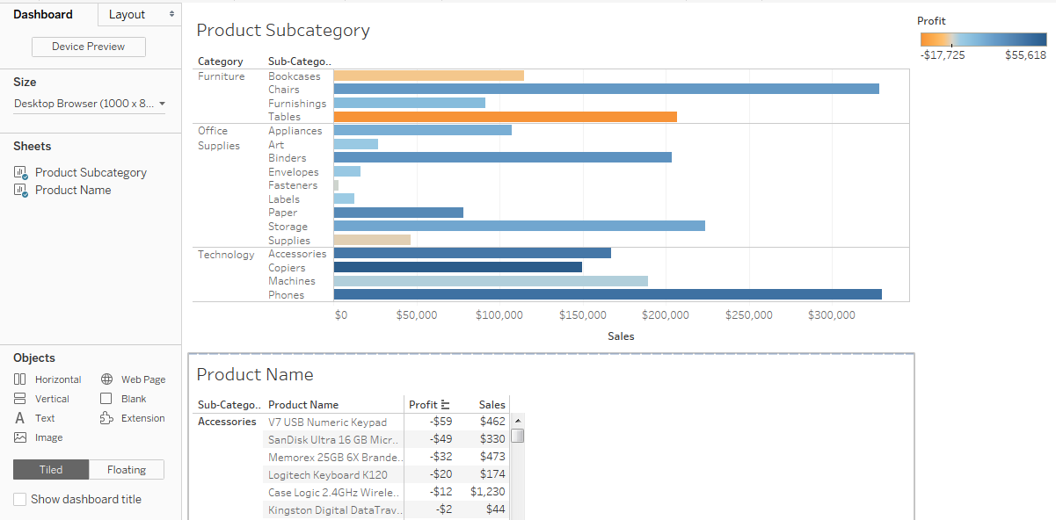
Filtering Exercise
Using the Superstore data, please create the following dashboard:

Slide 3
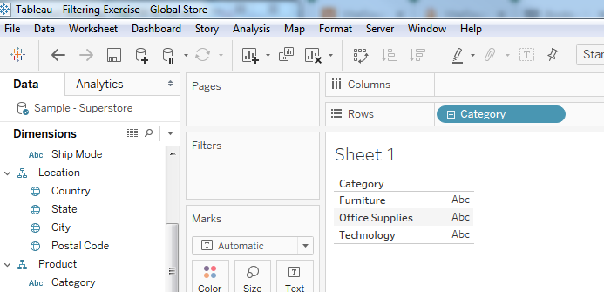
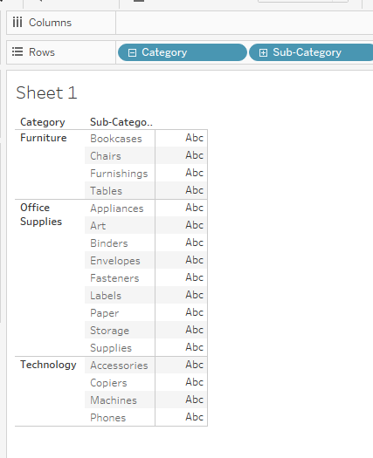
Filtering Exercise -1
Using the Sample – Superstore data
Create a new sheet
Drag the Category Dimension onto the worksheet
Expand Category by clicking on the “+”
Drag the Sales Measure onto the table
Drag the Profit Measure onto the Color Marks
Change the display to a bar display using “Show Me”
Rename the Sheet to “Product subcategory”

Slide 4
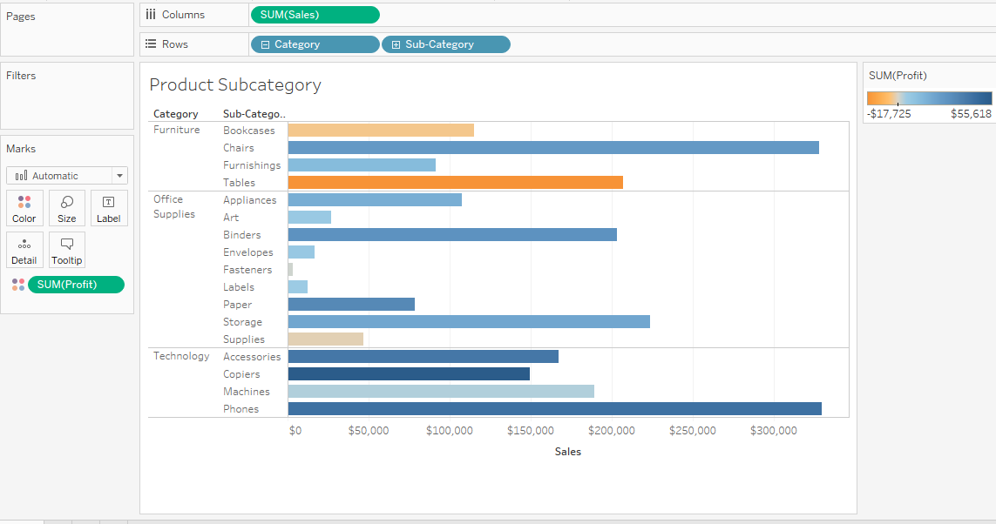
Filtering Exercise -2

Slide 5
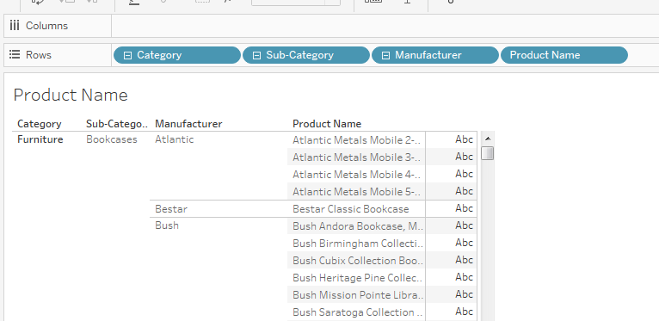

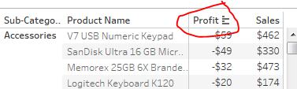
Filtering Exercise -3
Using the Sample – Superstore data
Create a new Sheet
Drag Category onto Rows
Expand Category until Product Name
Remove Category and Manufacturer
Add Sales and Profit
Sort Profit Ascending

Slide 6
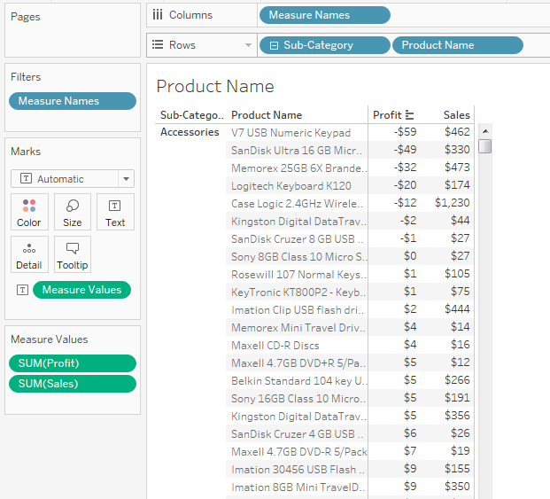
Filtering Exercise -4

Slide 7
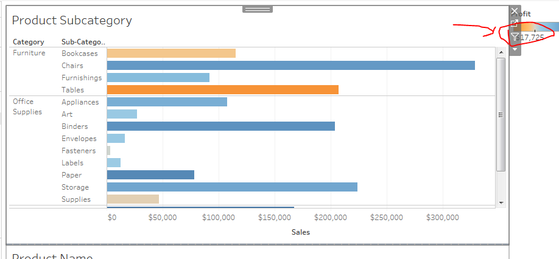
Filtering Exercise -5
Create a new Dashboard
Drop Product Subcategory sheet on top
Drop Product Name sheet on bottom
Select the “Use as Filter”

Slide 8
Filtering Exercise -6
For Accessories, what is the Product Name for the Highest Sales Item?
For Tables, what is the profit for the highest sales item? What is the product name?
For Bookcases, which one has the lowest profit?

